Slide 1
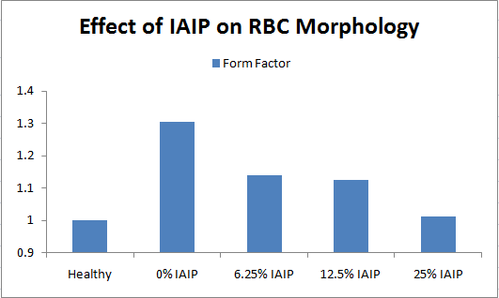
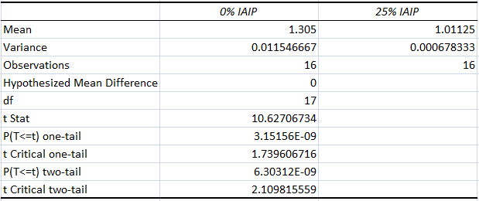
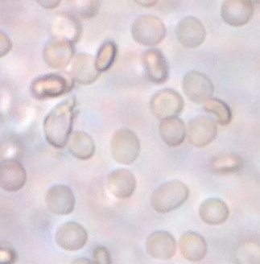
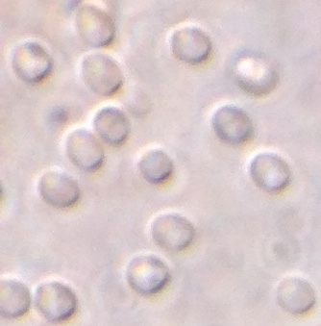
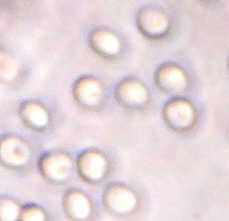
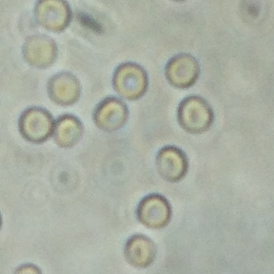
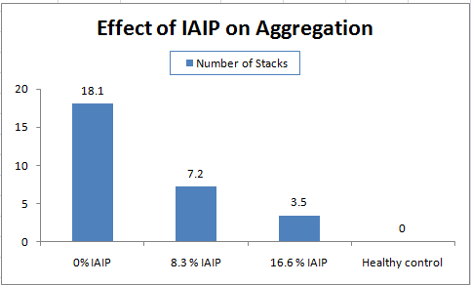
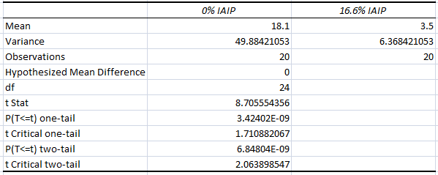
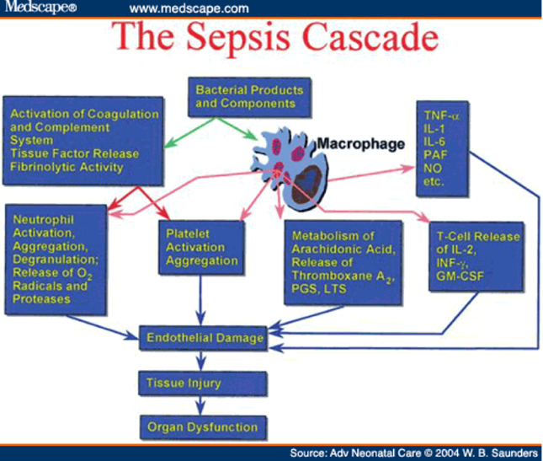
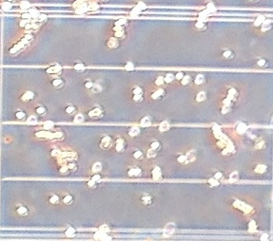
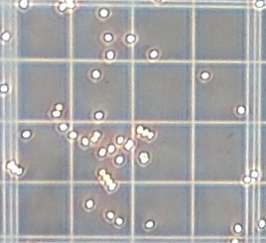
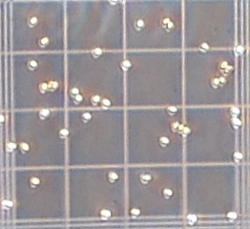
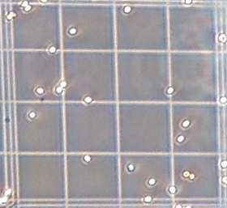
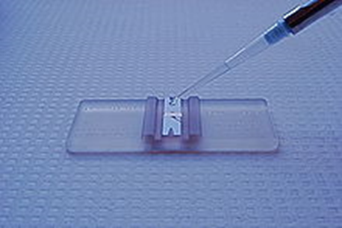
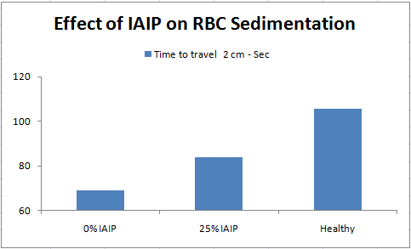
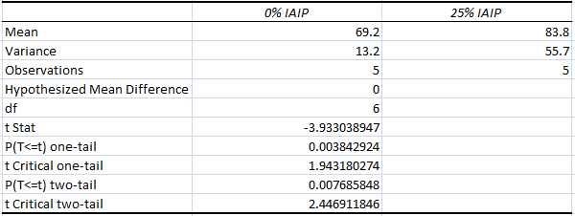
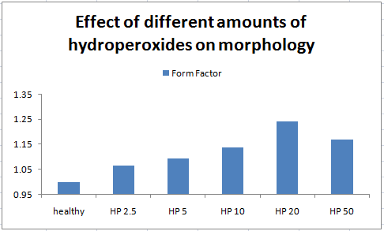
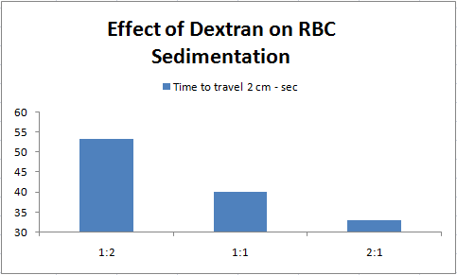
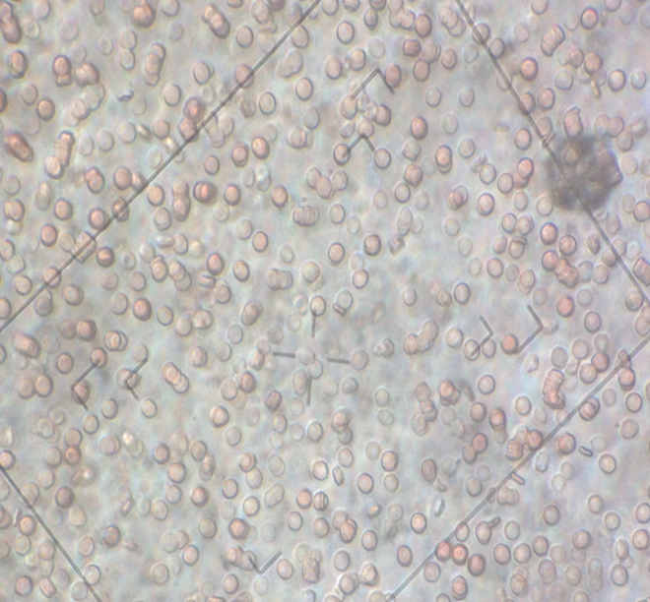
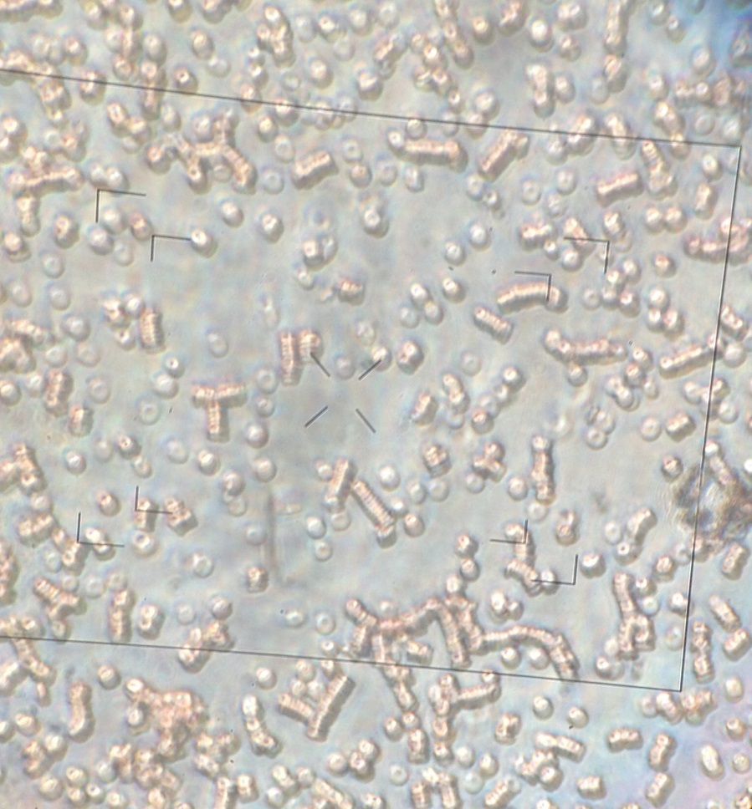
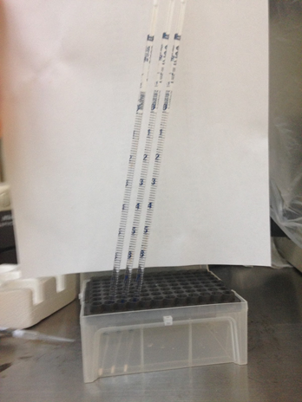
There will be a fold here
Inter-alpha inhibitors: the bacon of blood proteins
An investigation into the in-vitro interactions between Inter-alpha inhibitors and erythrocyte hemodynamics
Lance Wong
There will be a fold here
Purpose
Hypothesis
Results
Analysis
The purpose of this research is to investigate the effects of IAIP on different parts of the inflammatory cascade, more specifically red blood cell aggregation, sedimentation and morphology. Research in animal subjects show that IAIP is effective in treating a vast range of inflammatory diseases, but little is known on how or why. The purpose of my research is to examine the direct effect IAIP has on the conditions of blood introduced by inflammation.
Due to its prior success with neutrophils, I suspect that IAIP will prevent aggregation, reduce sedimentation rate and reduce form factor in affected erythrocytes.
The use of IAIP significantly reduces chemically induced erythrocyte aggregation, sedimentation, and morphology.
For aggregation, IAIP was able to almost entirely reverse the effects of dextran, a chemical. This is very promising and shows that IAIP will have an even greater effect as an anticoagulant in inflammation.
IAIP was also able to almost entirely reverse the damage caused by hydrogen peroxide, a ROS (Reactive Oxygen Species), which is commonly released during inflammation.
Further evidence in sedimentation rate shows that IAIP was able to significantly reduce aggregation.
Connecting the dots, IAIP shows that it can promote smoother blood flow and higher tissue perfusion in inflammatory diseases.
Also, IAIP is a serine protease inhibitor, which means that it protects against organ injury from proteases, showing significant therapeutic potential.
The results combined with previous information known about IAIP suggest that IAIP would be successful in treating a vast number of acute inflammation cases with no side effects.
From this study and other research, it can be understood that IAIP targets many parts of the inflammatory cascade.
This makes it a viable treatment even if administered late into the cascade.
For example, death in sepsis occurs when there is insufficient tissue perfusion to the brain, but IAIP serves both as an anticoagulant and a protease inhibitor, which allows it to reduce organ damage and to facilitate healing through smoother blood flow.
Traditional methods of thinning blood in sepsis include NSAIDs, or if severe enough, using the sepsis six.
Methods in the sepsis six include introducing new RBCs and oxygen into the system.
If IAIP was introduced, it would increase the tissue perfusion ability of the residing RBCs and aid the new RBCs in even higher tissue perfusion
IAIP does not affect platelet activity, making it even more suitable as an inflammatory disease treatment
Potentially, a micro-capillary machine could be used to test for the efficiency before and after treatment for passing through micro-capillaries.
In the future, research could be done in vivo to further confirm the in vitro evidence provided here.
Investigation of the effect of IAIP on RBC adhesion to the endothelium will also be done.
Methodology
Preparation of materials:
A dextran solution of 10mg/ml was created for aggregating cells.
This amount of dextran was found through testing different
amounts.
Blood was taken via finger prick.
A drop of blood was then put in a 1 ml tube with PBS and centrifuged at ~1800 rpm for about a minute.
The tube was then taken out and the PBS was removed, without disturbing the blood pellet and PBS was refilled to 1 ml.
The process was repeated 3 times with the last time refilling the blood solution up to 250 microliters with PBS.
This process was used to remove all IAIP from the system to prevent inaccurate results.
Testing for the effect of IAIP on RBC aggregation:
A microscope was used to take photos to inspect both aggregation and the morphology of cells.
A hemocytometer was used with the microscope to count the number of cell aggregates per defined area.
RBCs were put into a microplate and dextran and plasma were added to aggregate the cells. Then, IAIP was added in differing amounts to test for effectiveness.
To use the hemocytometer, 10 microliters of solution were pipetted into the slide, which disperses through capillary action.
The hemocytometer was then put under the microscope for inspection and data was recorded.
Background
Inflammation:
Inflammation is a response from body tissues to danger signals such as pathogens, damaged cells, or irritants used to protect itself from further harm.
Inflammation is necessary for survival as it facilitates tissue repair.
While minor inflammatory responses are crucial for all instances of healing, severe inflammatory responses could fatally damage the body.
Sepsis is an example.
Sepsis is common and
often deadly. It still
remains the primary
cause of death from
infection, despite
advances in modern
medicine.
When an inflammatory response has been triggered, IAIP levels have been found to drop.
When protease levels do not equal protease inhibitor levels, sepsis related tissue damage occurs and it is known to be fatal.
IAIP:
Inter-alpha inhibitor protein (IAIP) is a naturally occurring blood protein found in high concentrations in all mammals.
Current research suggests that IAIP plays a large role as an anti-inflammatory in the body.
IAIP increases the survival rates of mice with sepsis by around 90% by suppressing the proinflammatory cytokine activity.
IAIP reduces the mortality rate of mice with severe sepsis even with delayed administration.
IAIP increases the survival rate of mice from 0% to 71% in anthrax.
IAIP also reduces the effects of histone induced injuries.
It is currently known that IAIP has therapeutic values in treating inflammation, however it is not know what part of the inflammation cascade it targets.
0% IAIP 6.25% IAIP 12.5% IAIP 25% IAIP
# of aggregates per 100nl of solution
Discussion
0% IAIP 8.3% IAIP 16.6 % IAIP Healthy
Hemocytometer shown here
Testing for the effect of IAIP on RBC morphology:
Hydroperoxides were used to distort RBCs.
RBCs were put into a microplate with hydroperoxides which distorted RBCs to be oval instead of perfect circles
IAIP was then introduced in differing amounts to test for its ability to reverse the damage done by oxidation
The microplate was then put under the microscope and photos were taken
The photos were later analyzed for form factor
Testing for the effect of IAIP on RBC sedimentation:
Traditional methods are very expensive and time consuming.
I created a new ESR device that could measure sedimentation rate quicker and cheaper.
The device consisted of a glass tube with markings on the side filled with a 2.5% glycerol solution and was sealed at the bottom with clay.
Differing amounts of dextran were used to test the ESR device for accuracy.
The blood solution then dropped in
through the top and the cells made
their way downwards with speeds
depending on the degree of aggregation.
Data was then recorded on the
sedimentation rates of various solutions
with differing amounts of IAIP in it.
Materials
Nikon diaphot microscope
Dextran 580 kDa purchased from Sigma Aldrich
Inter-alpha-Trypsin inhibitors purified by Prometic
Phosphate buffered saline
Hydrogen peroxide
Hemocytometer
Erythrocytes produced by finger prick
Depleted plasma by centrifuge from blood bank
Fibrinogen by centrifuge from blood bank
Eppendorf pipettes, sizes 20µl, 100µl, 200µl, and 1ml
Jitterbug microplate incubator
Torvex 3000 lab mixer
ThermoFisher Scientific microplate
iPhone for photography
Future Research
Figure 1 after treatment
Figure 2 before treatment
After 20 minutes of incubation, the effect of IAIP is clear. Before treatment, cells are aggregated as shown in Figure 2. After treatment (20 microliters of IAIP), they are aggregated as shown in Figure 1. Most signs of aggregation are no longer visible, and the erythrocytes now resemble healthy erythrocytes.
There will be a fold here
There will be a fold here

